Slide 1
ENERGY SCENARIO

Slide 2
What is Energy

Slide 3

What is Unit
1 k Wh
1k W = 1000 W
E.g
50 watt table fan runs for 10 hours/day then
50*10 = 500 W
0.5 k Wh
Say 1 k Wh price is Rs 7
Then for fan is consuming Rs 3.5 Rs/per day.

Slide 4
Energy applications
Household
Commercial buildings
Industry
Agriculture etc

Slide 5
Forms of Energy
Thermal energy-eg. IC Engines
Chemical energy- Biomass bioenergy
Electrical energy-commonly used
Mechanical energy-used in transportation, agriculture

Slide 6
ton of oil equivalent
Tonne of oil equivalent (toe) is a unit of energy, defined as the amount of energy released by burning one tonne (1000 Kilograms) of crude oil.

Slide 7
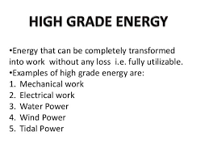
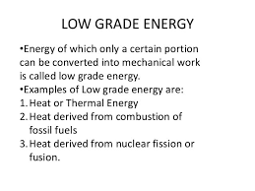
Forms of Energy

Slide 8
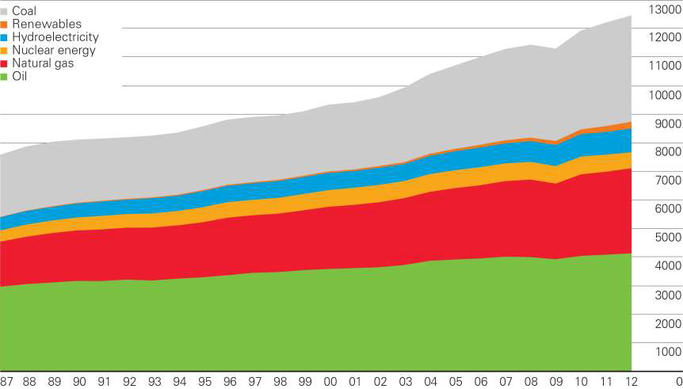
Progress of energy use (World scenario)
Primary Energy World Consumption (courtesy British Petroluem 2013)
(Million tonnes oil equivalent)

Slide 9
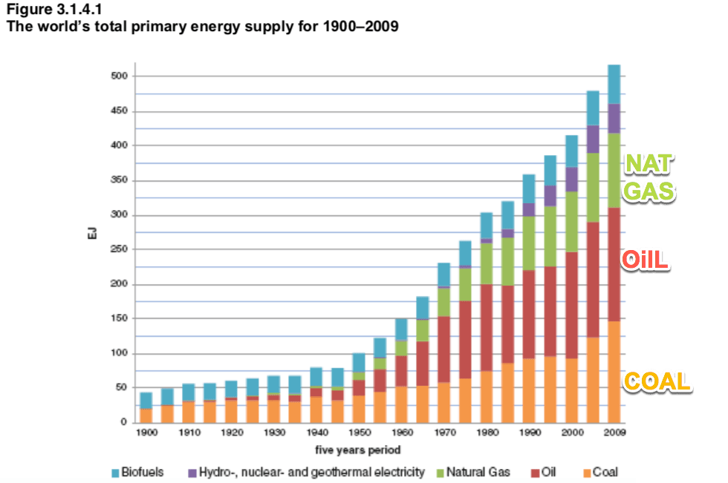
The exajoule (EJ) is equal to one quintillion (10¹⁸) joules.

Slide 10
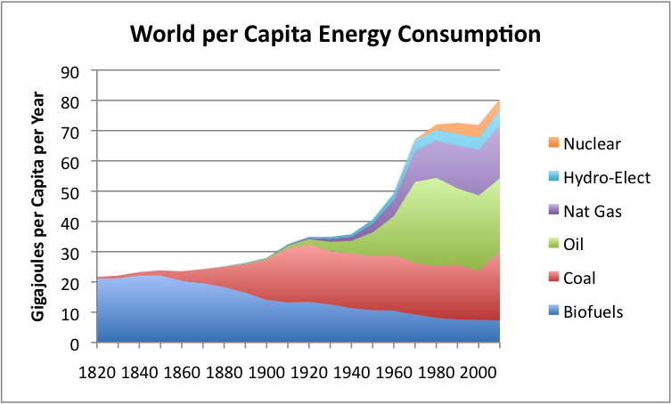

Slide 11
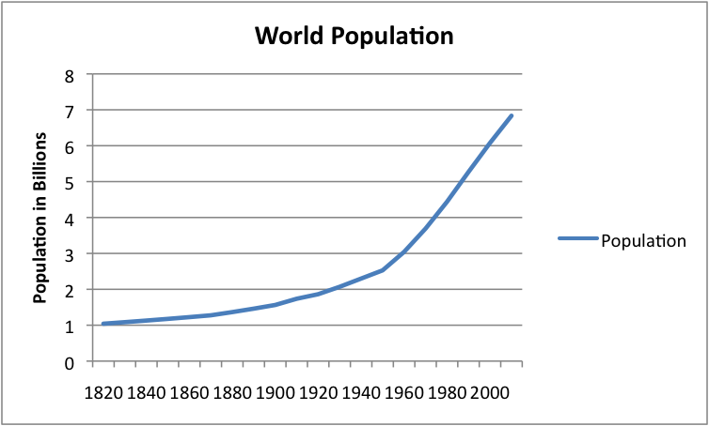

Slide 12
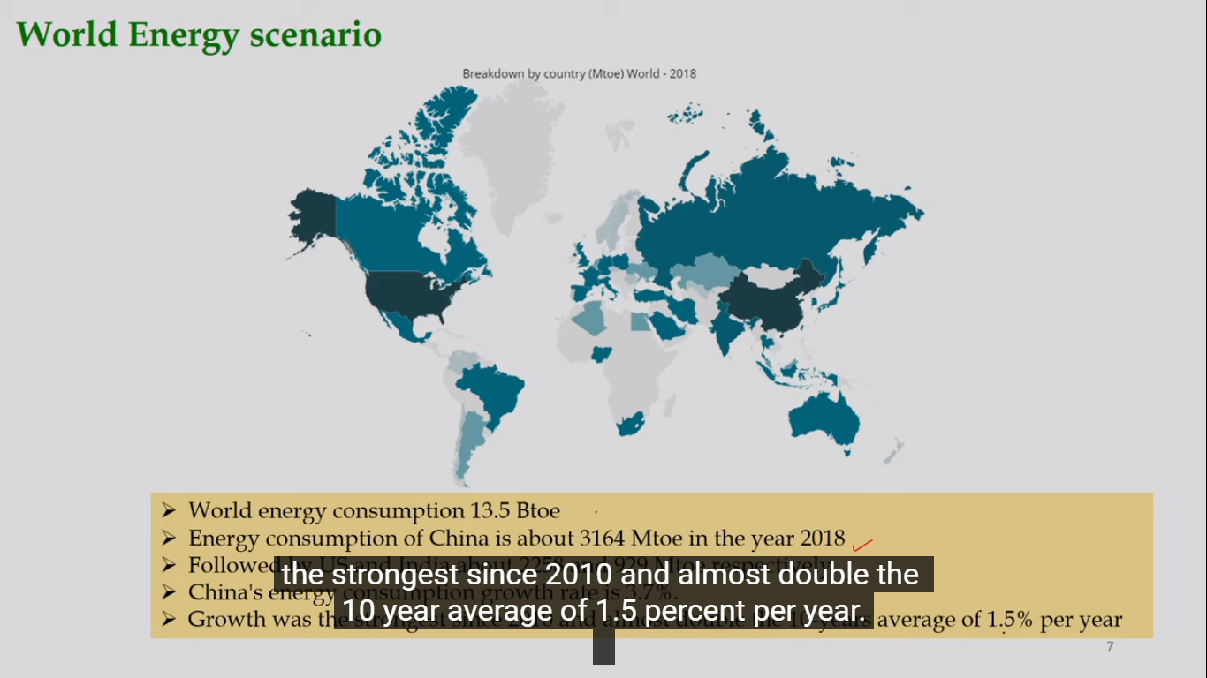
Followed by US and India 2258 and 929 Mtoe respectively
Notes:
Followed by US and India 2258 and 929 Mtoe

Slide 13
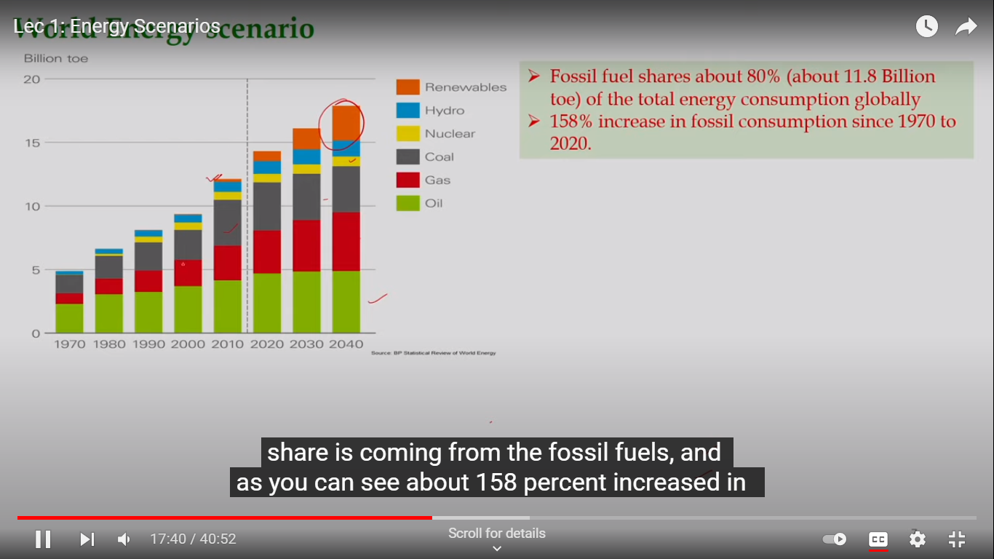
World energy scenario
Notes:
World energy scenario

Slide 14
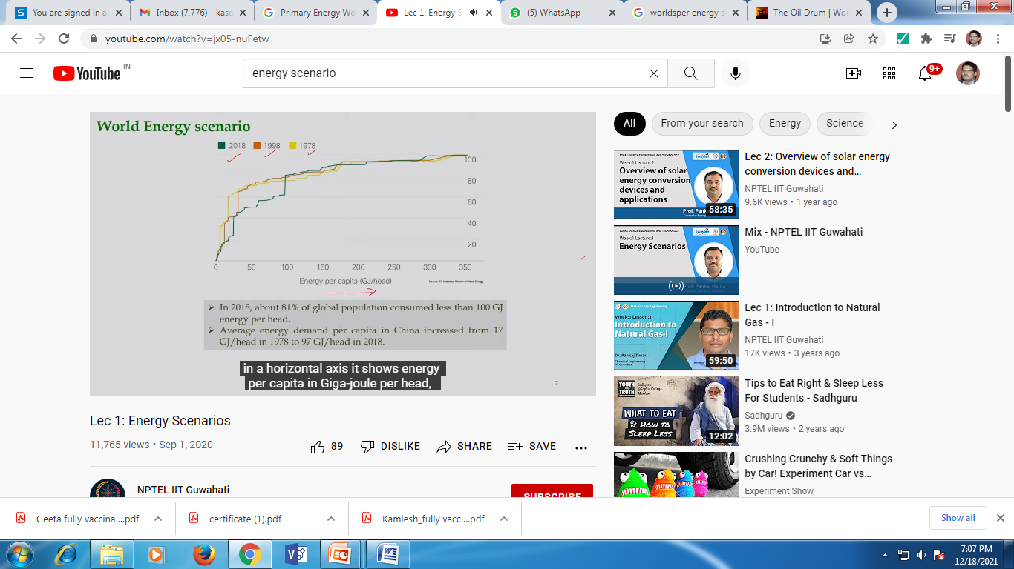

Slide 15
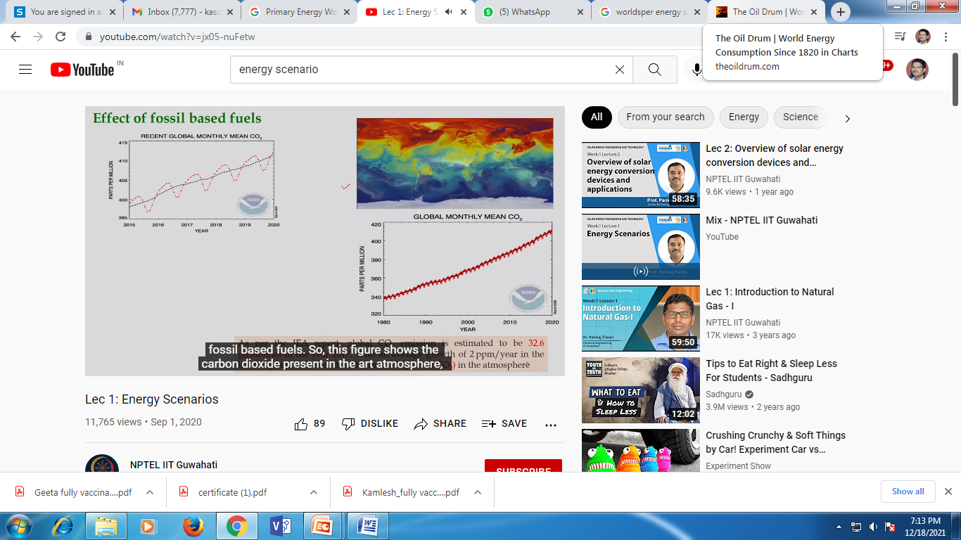
Red color
CO2
CO2 emission is estimated to be 32 Gigatonnes in the year 2017
Climate change
Notes:
CO2 emission is estimated to be 32 Gigatonnes in the year 2017
Climate change

Slide 16
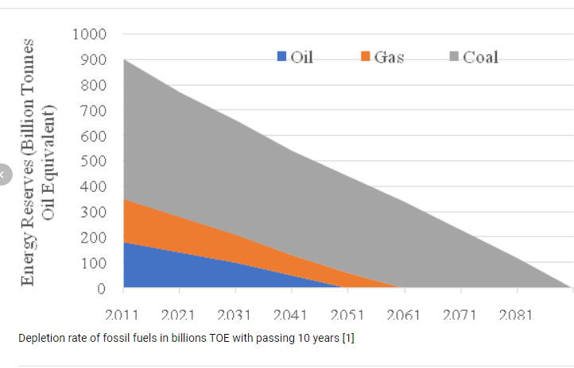

Slide 17
Why alternative energy sources
Prices of crude oil
Energy security
Energy sustainability
Notes:
Why alternative energy sources

Slide 18
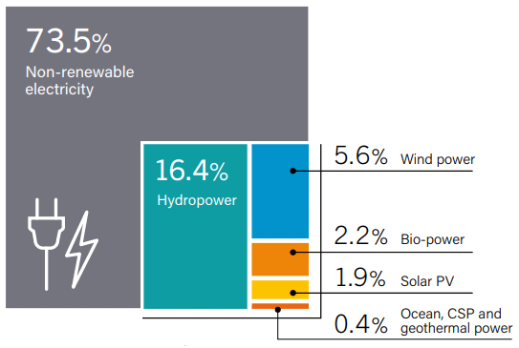
Estimated renewable energy share of global electricity production, end-2017
Notes:
Estimated renewable energy share of global electricity production, end-2017

Slide 19
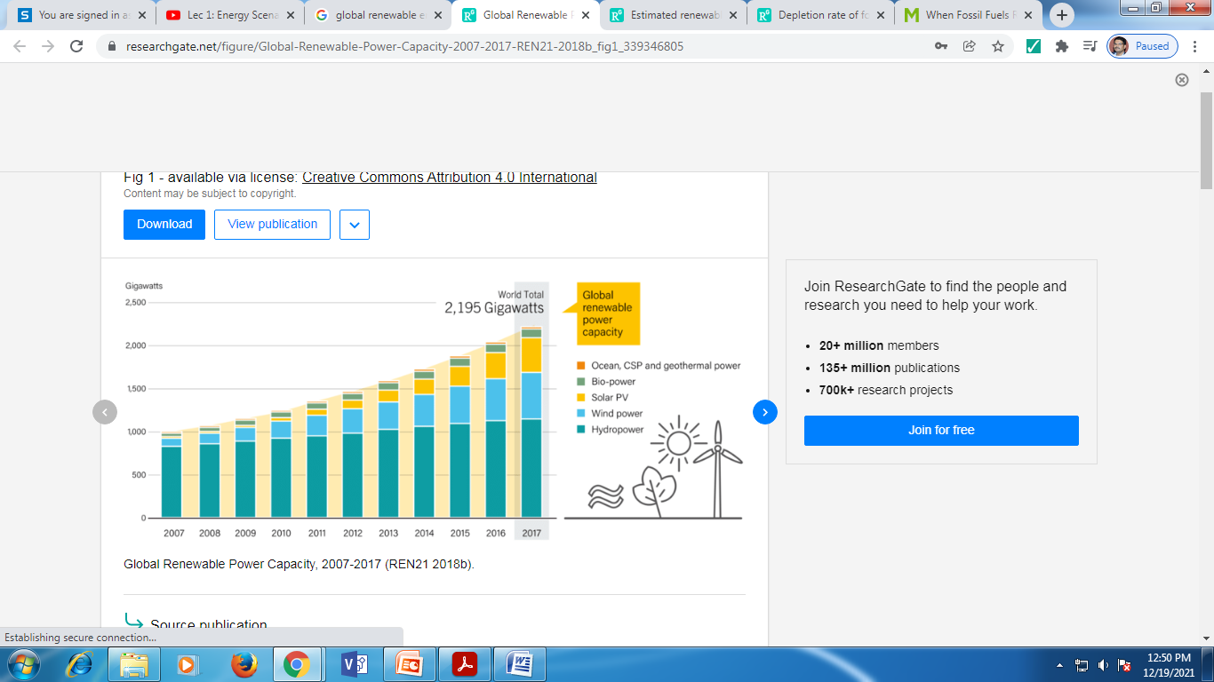
CSP = Concentrated solar power
Notes:
CSP = Concentrated solar power

Slide 20
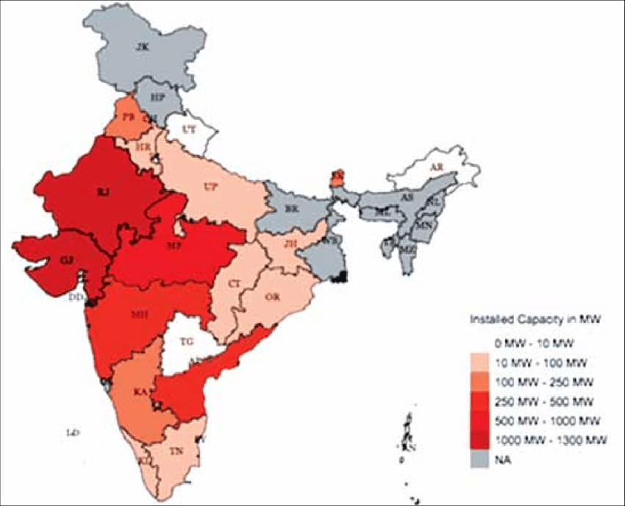
Installed solar power capacity in India by 2015.

Slide 21
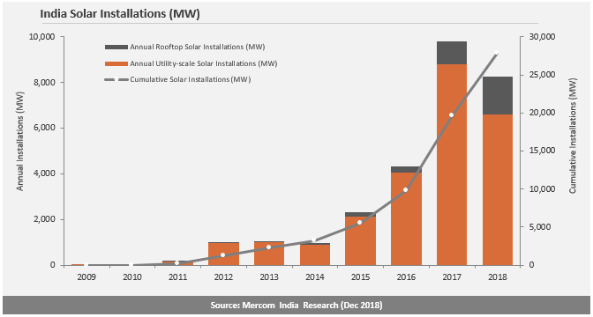

Slide 22
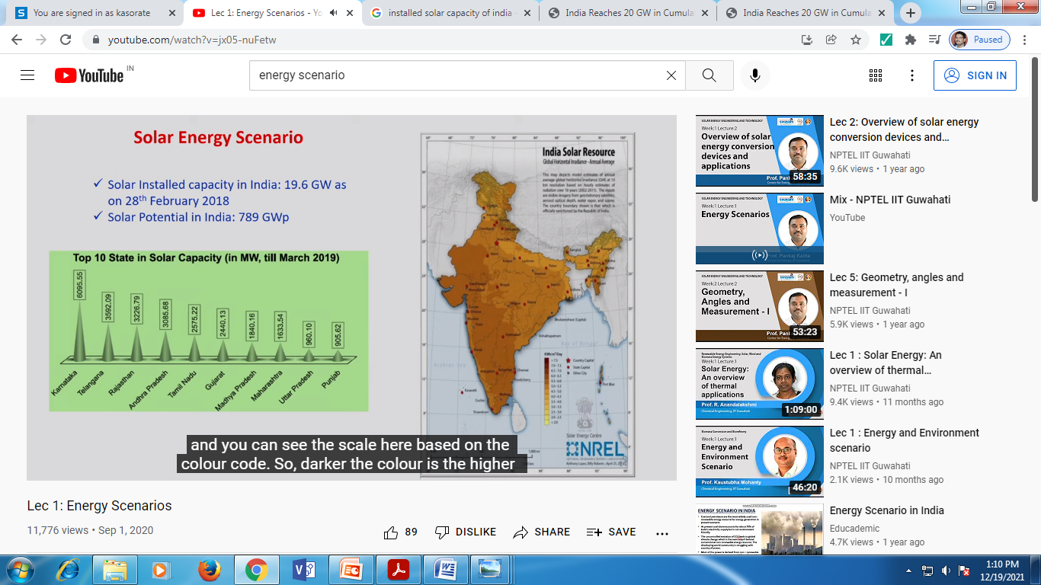

Slide 23
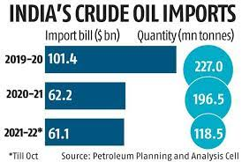

Slide 24
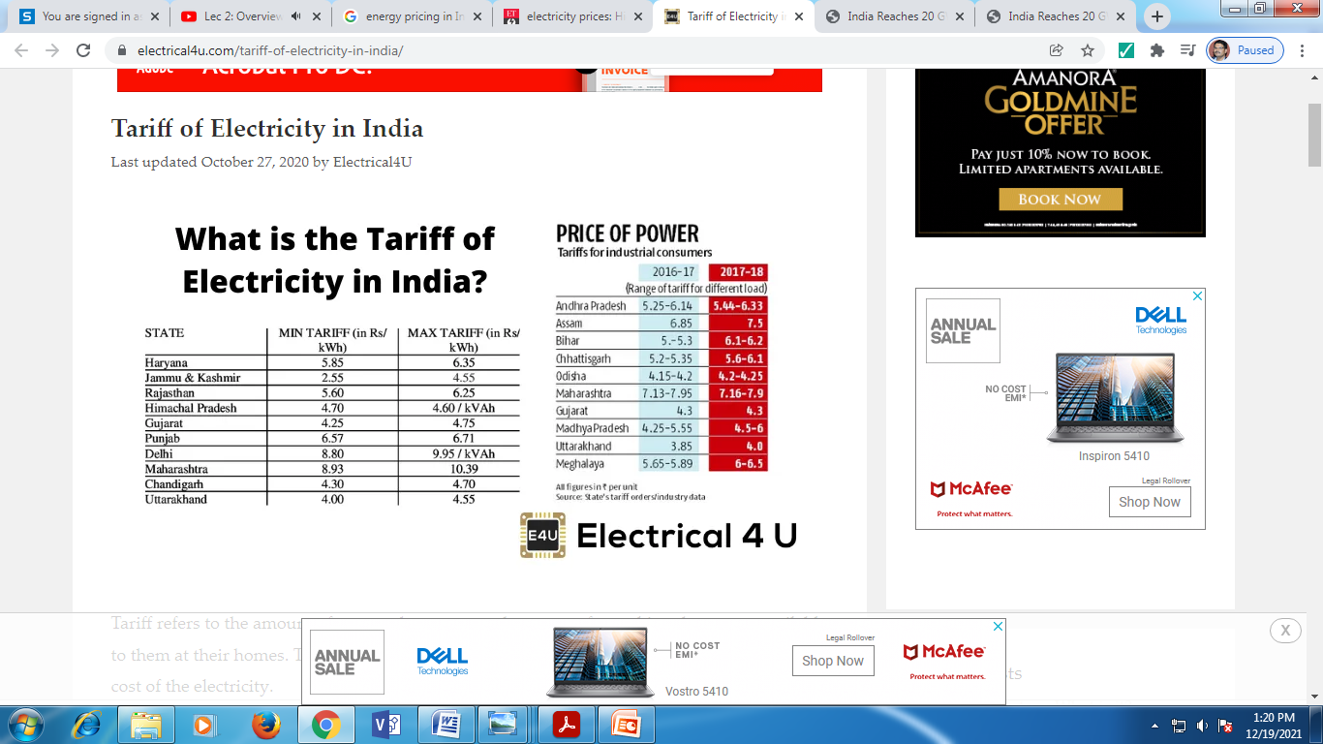

Slide 25
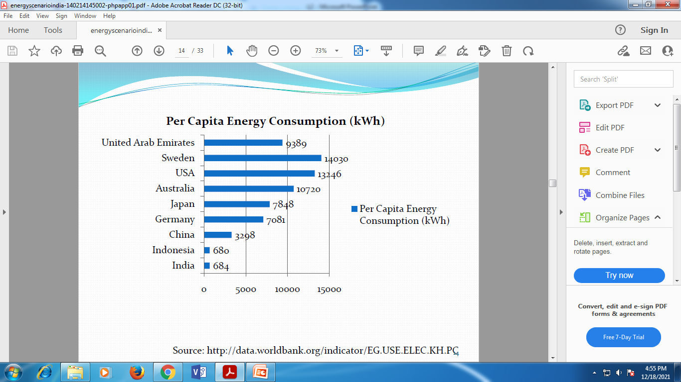

Slide 26
